Slide 1
BREAK FAILURE INDICATOR

Slide 2
Presented By
01
Md. Omar Faruk Sakib
21-45077-2
Get a modern PowerPoint Presentation that is beautifully designed.
02
Md. Abu Hojifa
21-45081-2
Get a modern PowerPoint Presentation that is beautifully designed.
03
Ashfat Ahmed Medul
21-44854-2
Contents Here
04
Amina Tazin
21-45141-2
Contents Here
05
Contents Here
Md. Najib Hossain
21-45366-2

Slide 3
Table of Contents
01
Introduction
Working
Circuit Diagram
Components
Advantages
Applications
Conclusion
02
03
04
05
05
06
07

Slide 4
Introduction
Break wire does not alert you before it breaks. However, a brake failure
indicator will alert you, which can be a life saver.
So, in this project we'll create a Brake Failure Indication Circuit using a
555 Timer IC, which we can mount to our vehicles.

Slide 5
Working
A circuit that continuously checks the state of the brake is known as a brake failure indicator circuit. By keeping an eye on the brake switch, the sensor keeps track of the circuit for a brake failure and alerts you each time the brake is applied to the status of the brake. The vehicle's braking system is connected by a brake wire, which travels from the brake lever. When we press the brakes to our car to halt, this wire is what is pulled.

Slide 6
Components
555 Timer
0.1uf capacitor
1uf capacitor
Buzzer
BC557 PNP transistor
Led
1K resistor
470k resistor
Jumper wire
Brake wire
9V Battery as a power source
Battery clip for connection
Breadboard

Slide 7
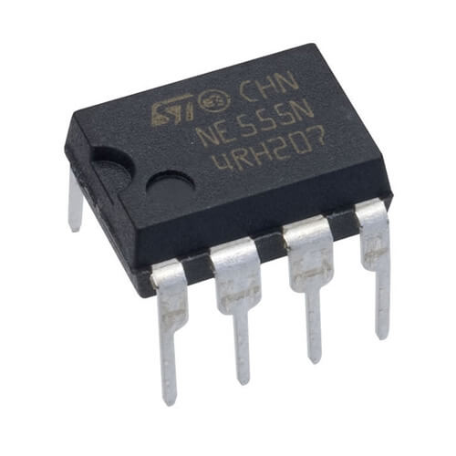
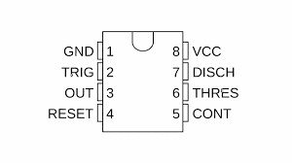
555 Timer
What is a 555 timer?
The 555 timer is a versatile integrated circuit.
Used astable mode
Drives the buzzer.
Maintain the timer to work for 0.3 seconds
on time and 0.3 seconds off time.
Applications of the 555 timer in our project.

Slide 8
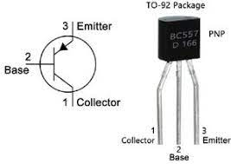
PNP Transistor
What is a PNP transistor?
PNP transistors are a type of bipolar junction transistor.
Characteristics of a PNP transistor
PNP transistors are current-controlled devices.
How PNP transistor used in our project
As a switch to turn on and off the buzzer.

Slide 9
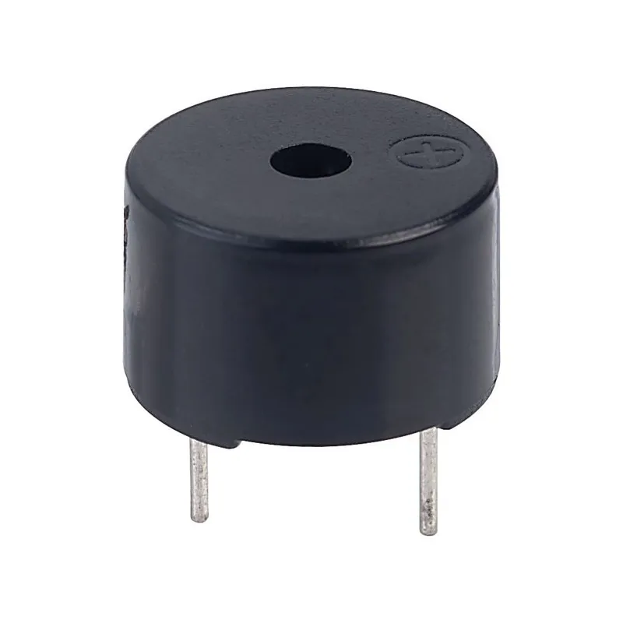
Buzzer
A buzzer is an audio signaling device, which may be mechanical, electromechanical, or piezoelectric (piezo for short). Typical uses of buzzers and beepers include alarm devices, timers, and confirmation of user input such as a mouse click or keystroke.

Slide 10
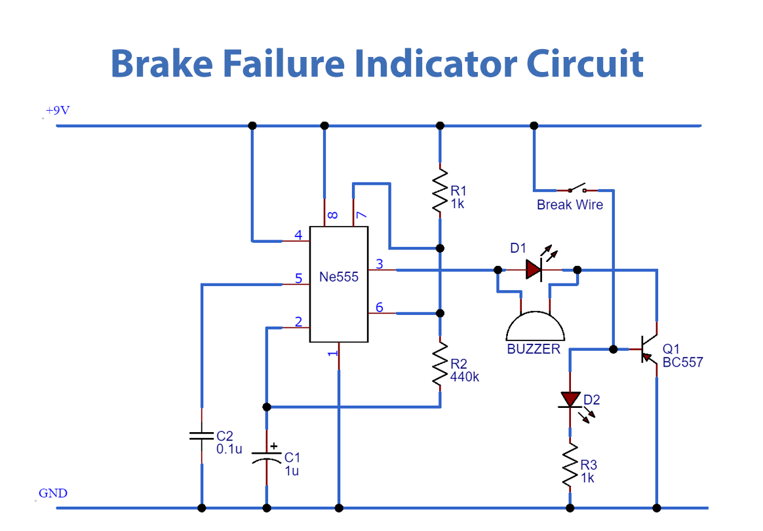
Circuit Diagram

Slide 11
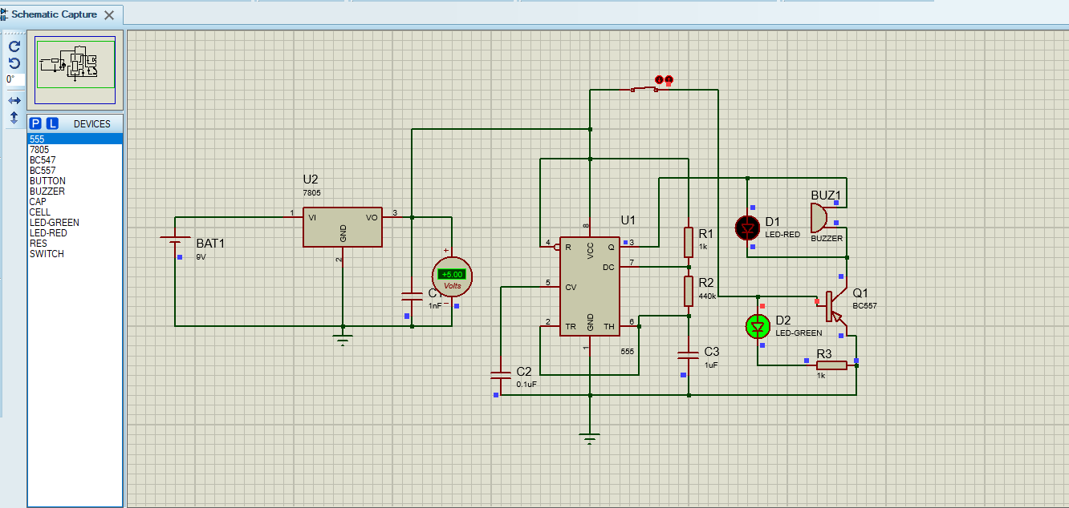
Simulation
If brake wire is okay:

Slide 12
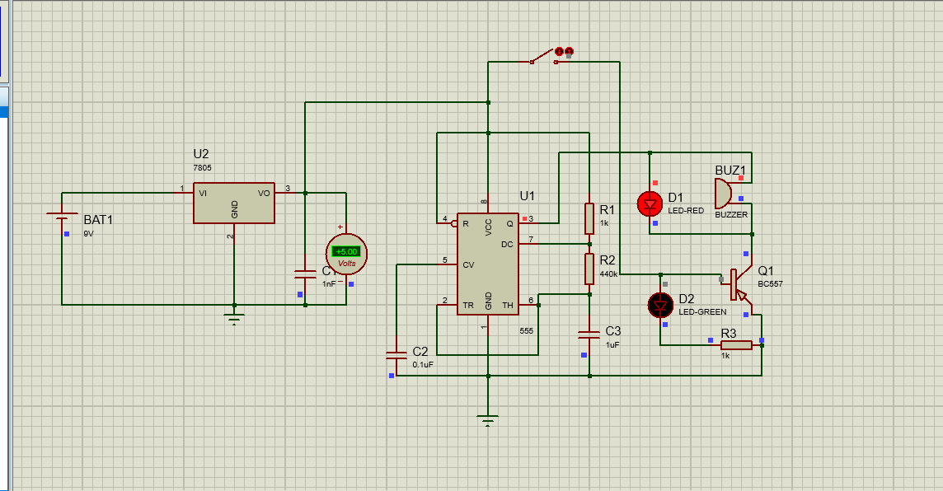
Simulation
If brake wire fails: :

Slide 13
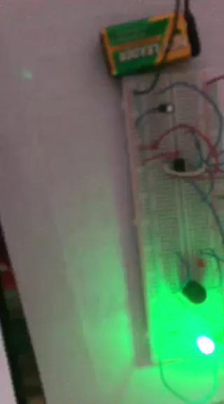
Project Video

Slide 14
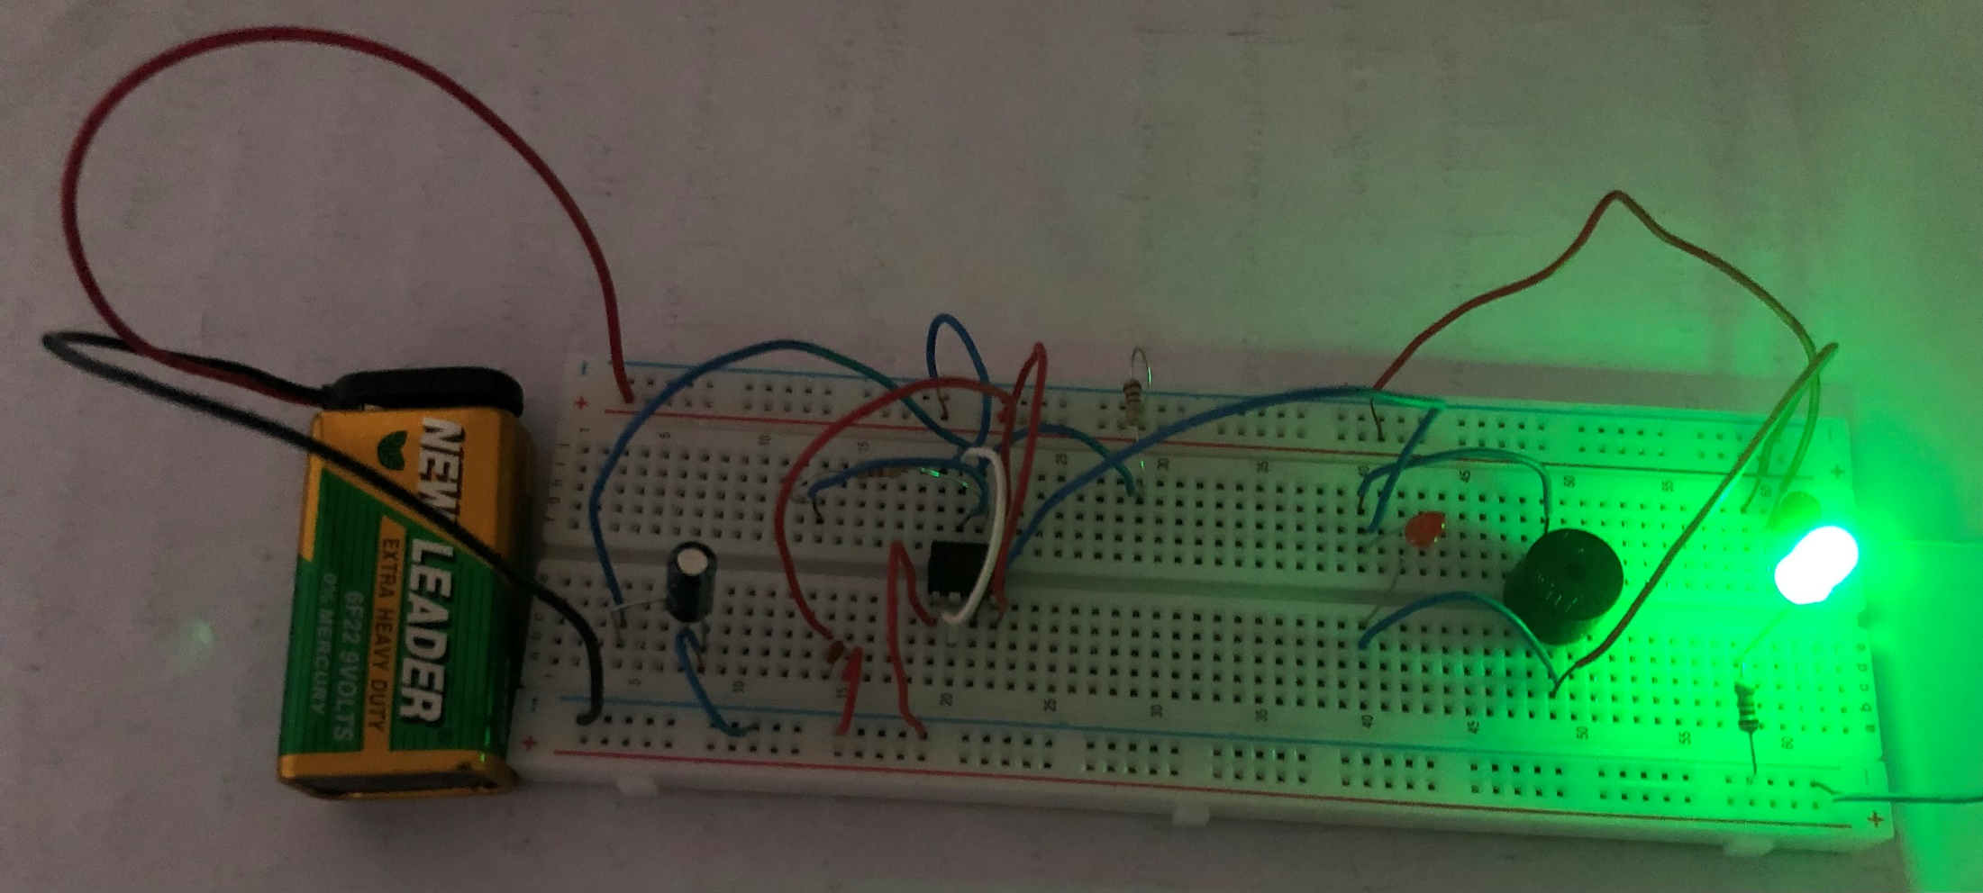
Hardware Implementation
If brake wire is okay:

Slide 15
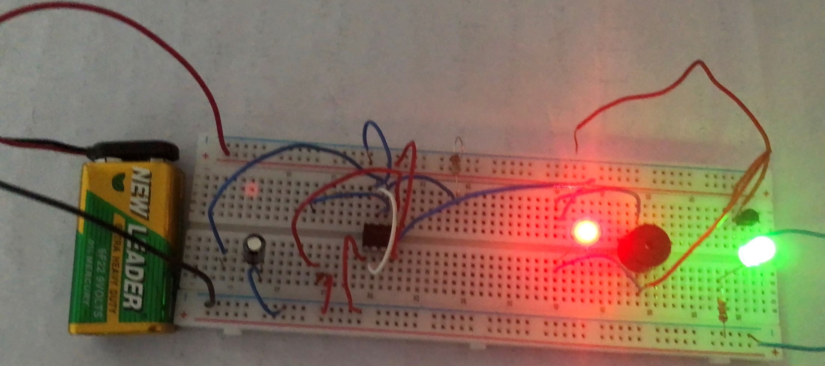
Hardware Implementation
If brake wire fails:

Slide 16
Advantages
No need for an external battery.
Circuit can be powered from the vehicle's battery itself.
Power consumption is comparably less.
It is not dependent on the petrol level.
Operating principle is very easy.
Installation is simplified very much.
The safety of driver is ensured.
Brake failure is notified to the surrounding traffic via buzzer.
The cost is low

Slide 17
Applications
Four-wheeler application
Two-wheeler application
Mechanical Crane
Mechanical machines

Slide 18
Conclusion
A system for early warning is the brake failure indication.
It provides audio visual cues and continuously assesses the brake's condition.

Slide 19
THANK YOU

